Slide 1
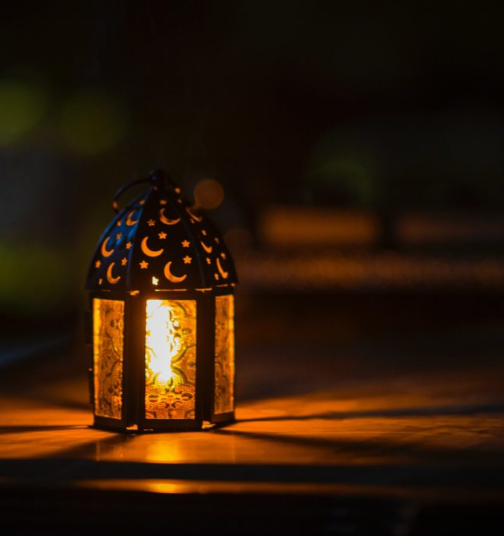
Ramadan quiz
How much do you know about Ramadan?

Slide 2
When do Muslims fast during Ramadan?
A. From dawn to sunset
B. From sunset to dawn
D. From morning to afternoon
C. From 6am to 7pm

Slide 3
When do Muslims fast during Ramadan?
A. From dawn to sunset
B. From sunset to dawn
D. From morning to afternoon
C. From 6am to 7pm

Slide 4
2. The holy month of Ramadan marks what occasion:
A. The birth of the Prophet Muhammad
B. The revelation of the Qu’ran to the Prophet Muhammad
C. The Prophets ascension into heaven (Jannah)
D. Muhammad's journey to Mecca

Slide 5
2. The holy month of Ramadan marks what occasion:
B. The revelation of the Qu’ran to the Prophet Muhammad
A. The birth of the Prophet Muhammad
C. The Prophets ascension into heaven (Jannah)
D. Muhammad's journey to Mecca

Slide 6
3. The spirit of Ramadan is primarily one of:
A. Parties
B. Mourning and sadness
C. Introspection, reflection and purification
D. Pilgrimage and spiritual travel

Slide 7
3. The spirit of Ramadan is primarily one of:
A. Parties
B. Mourning and sadness
C. Introspection, reflection and purification
D. Pilgrimage and spiritual travel

Slide 8
4. Ramadan officially begins with:
A. Sunrise
B. Sunset
D. The moment the first star is visible in the night sky
C. The sighting of a new moon

Slide 9
4. Ramadan officially begins with:
A. Sunrise
B. Sunset
D. The moment the first star is visible in the night sky
C. The sighting of a new moon

Slide 10
5. What is Iftar?
A. The meal eaten after sunrise
B. The celebration marking the end of Ramadan
D. The Prophet Muhammad's birthplace
C. The meal eaten after sunset

Slide 11
5. What is Iftar?
A. The meal eaten after sunrise
B. The celebration marking the end of Ramadan
C. The meal eaten after sunset
D. The Prophet Muhammad's birthplace

Slide 12
6. During Ramadan, which of the following are not required to fast?
A. Pregnant women and young children
B. The elderly and those who are ill
C. All of the above
D. None of the above, everyone must fast

Slide 13
6. During Ramadan, which of the following are not required to fast?
A. Pregnant women and young children
B. The elderly and those who are ill
C. All of the above
D. None of the above, everyone must fast

Slide 14
7. During the month of Ramadan, Muslims are also encouraged to do the following, except:
A. Read the entire Qu’ran during the month
B. Pray five times a day
C. Give to charity and perform charitable acts
D. Follow a vow of silence for at least one day

Slide 15
7. During the month of Ramadan, Muslims are also encouraged to do the following, except:
A. Read the entire Qu’ran during the month
B. Pray five times a day
D. Follow a vow of silence for at least one day
C. Give to charity and perform charitable acts

Slide 16
8. Eid-ul-Fitr is a celebration that marks what occasion?
A. A day of celebration marking the first day of the month following Ramadan
B. The beginning of Ramadan
C. The Prophet Muhammad's arrival in Mecca
D. The building of the first Mosque

Slide 17
8. Eid-ul-Fitr is a celebration that marks what occasion?
A. A day of celebration marking the first day of the month following Ramadan
B. The beginning of Ramadan
C. The Prophet Muhammad's arrival in Mecca
D. The building of the first Mosque

Slide 18
9. The Suhar is…
A. A special prayer said before sundown
B. A two day period after the end of Ramadan
C. The name for a visit to any Mosque
D. The meal eaten before sunrise during Ramadan

Slide 19
9. The Suhar is…
A. A special prayer said before sundown
B. A two day period after the end of Ramadan
C. The name for a visit to any Mosque
D. The meal eaten before sunrise during Ramadan

Slide 20
10. The Laylat Al Qadr, or the Night of Power, is commemorated as:
B. The Prophet Muhammad's journey to Medina
The Islamic New Year
C. The night the Prophet Muhammad received the first revelation of the Qu’ran
D. The first night of Ramadan

Slide 21
10. The Laylat Al Qadr, or the Night of Power, is commemorated as:
B. The Prophet Muhammad's journey to Medina
The Islamic New Year
C. The night the Prophet Muhammad received the first revelation of the Qu’ran
D. The first night of Ramadan

Slide 22
11. Why does the date of Ramadan vary?
Ramadan follows the lunar calendar
B. The length of the days
D. To tie in with other religious events
C. The season

Slide 23
11. Why does the date of Ramadan vary?
Ramadan follows the lunar calendar
B. The length of the days
D. To tie in with other religious events
C. The season

